Slide 1
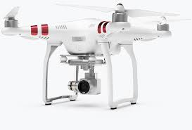
Search and Rescue Assistant
Group 8
Sahana Asokan
Won Seok Chang
Avnish Patel
Abhishek Chaudhuri
Shantanu Ghosh
Srikrishnaraja Mahadas
Sri Sai Krishna Tottempudi
Vishal Venkateswaran

Slide 2
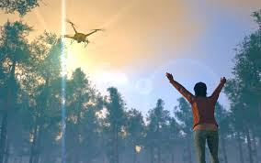
Overview
Purpose: To cover more area more efficiently and safely without or minimum need of a helicopter or first responders in case of emergency.
Increase the number of lives saved
Decrease the number of lives of first responders lost
Important Features:
Check Obstacles
Real-time View
Safe & Durable
Easy Access / Ready-to-launch

Slide 3
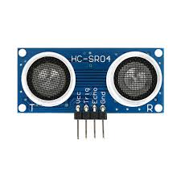
Sensors
The sensors used in the drone range from external to internal sensors (i.e Sensors that are embedded in other devices and sensors that serve a single purpose externally).
External:
HC-SR04 [Ultrasonic Sensor] - Used for detecting any obstacles around the drone and notify the user of its’ distance from the drone.
Internal:
Accelerometer - Inside the smartphone; Measures the acceleration of the drone.
GPS - Also inside smartphone; Measures the geolocation of the drone.

Slide 4
Website and Geolocation
We are able to track the location of the camera when it is connected to the webpage interface.
The camera is able to stream its video feed to the user on the interface
The battery status of the camera is able to be displayed on the webpage
The camera’s current position in terms of latitude and longitude is displayed

Slide 5
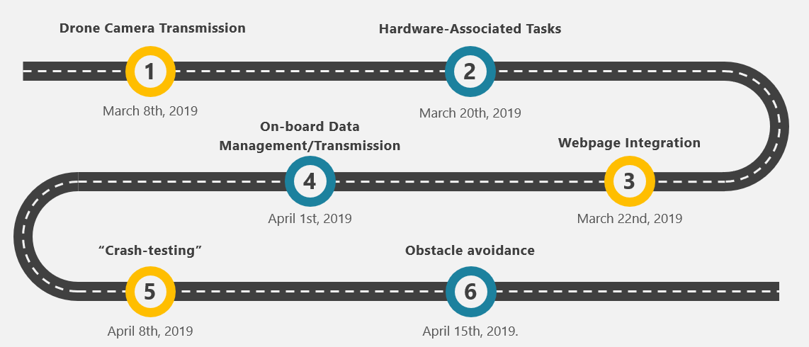
Project Roadmap

